Slide 1
Da Vinci Robot Needle Pose Path Planning
By: Jayesh Jayashankar, John Draganov

Slide 2
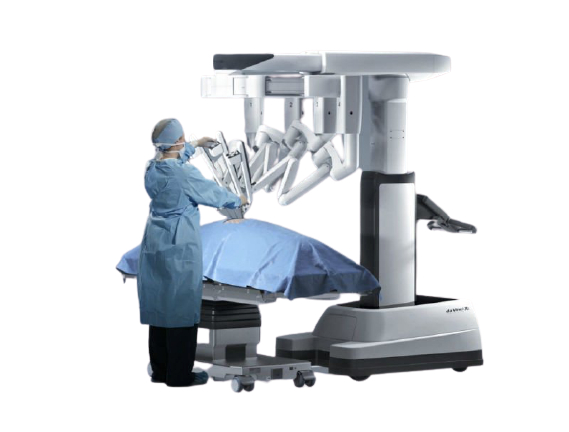
Introduction
The growth of surgical robots can be attributed to the the limitations of minimally invasive surgery, the technological advancements and the increased research in the applications of medical robotics.
The global market for surgical robots is projected to be around USD 14.4 billion by 2026.
The COVID-19 pandemic would also cause a lot of surgical procedures to be carried out using a robotic instrument to prevent the transmission of the disease.
Some of the advantages of surgical robots include less blood loss, reduced recovery time and infection risk.

Slide 3
Motivation
The motivation behind this project was based on the paper “Dual-Arm Needle Manipulation with the da Vinci ® Surgical Robot” [1].
This paper using the RRT algorithm to efficiently perform needle grasping, regrasping and handoff operations.
An efficient grasping strategy is required to grasp and regrasp the needle in an optimal manner for the suturing process in a surgical procedure to take place.
The needle handoff procedure is carried out by the two arms which hands off the needle between each other until the needle can be grasped in a way that is optimal for insertion into the respective tissue.
Based on the above idea we are looking to implement the RRT path planning algorithm to handoff the needle from one arm to the other and to find the optimal path to generate the final end effector (needle) pose.

Slide 4
Plan of Action
Making/ retaining changes of a custom Solidworks model of a Da Vinci robot.
Implementation of FWD Kinematics to change between World and joint parameters OTF
Implementation of the RRT path planning algorithm to find the shortest distance.
Simulation of the path planning algorithm by adding obstacles.
Application of inverse kinematics to compute the joint parameters.
Validation of model needle handoff with collision frames of gripper
Running simulation tests in Gazebo and verifying the same using MoveIt and RVIZ.

Slide 5
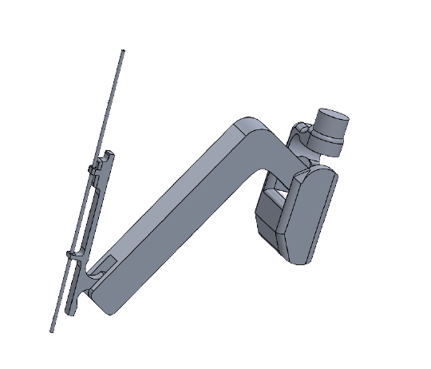
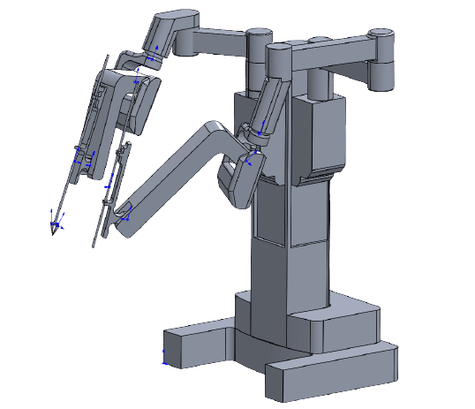
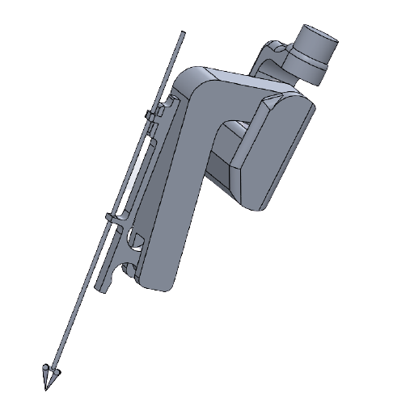
SolidWorks Model Creation
Da Vinci System created and edited in Solidworks
Mainly operating with needle arm
NB: Needle arm frame is higher than expected (not at tip)
Gripper Arm
Needle Arm

Slide 6
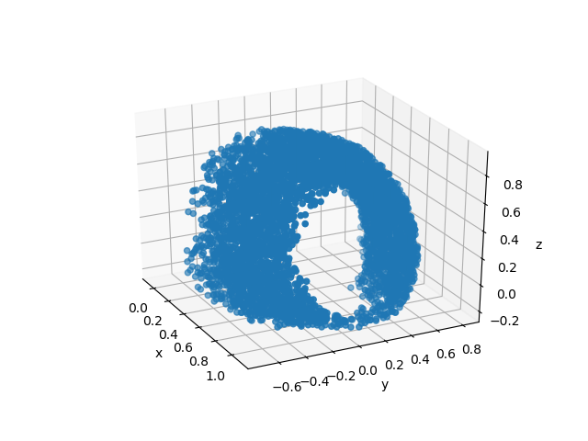
FWD Kinematics and Workspace

Slide 7

Inverse Kinematics: Verification

Slide 8
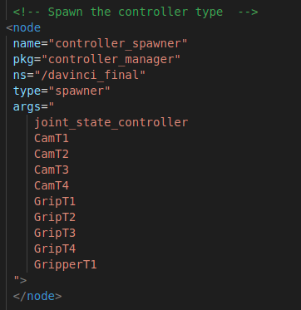
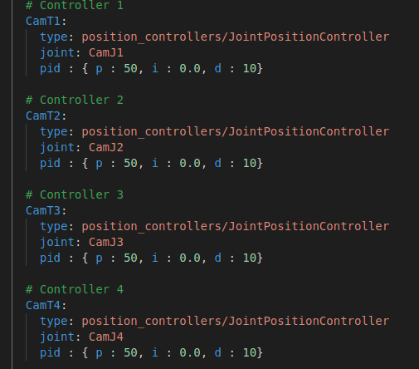
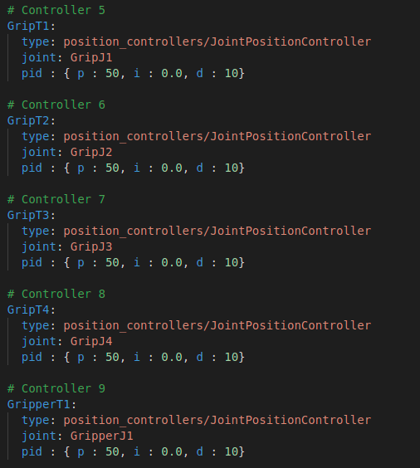
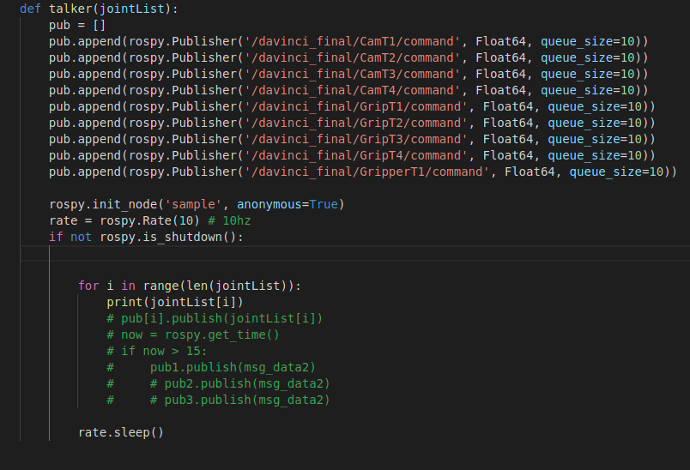
Controllers

Slide 9
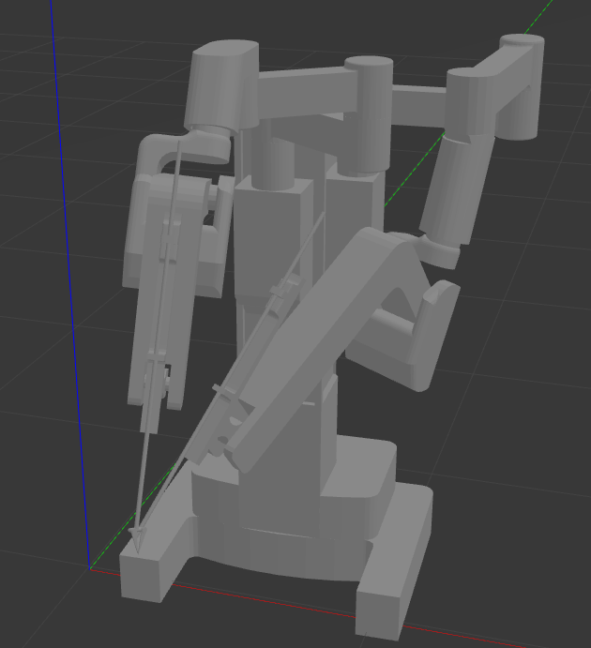
Path Planning
Execute Planner (RRT) and find shortest path (discretize as necessary)
FWD Kinematics to convert between frames
Feed points to IK solver -> Find joint parameters
Filter legal joint parameters
Move!

Slide 10
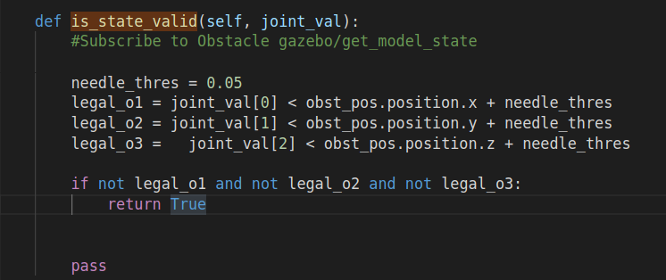
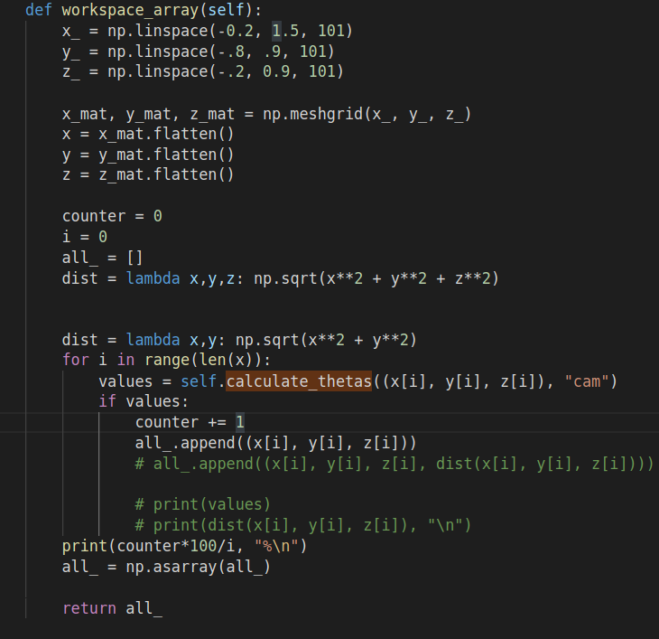
Path Planning (Code Snippets)

Slide 11
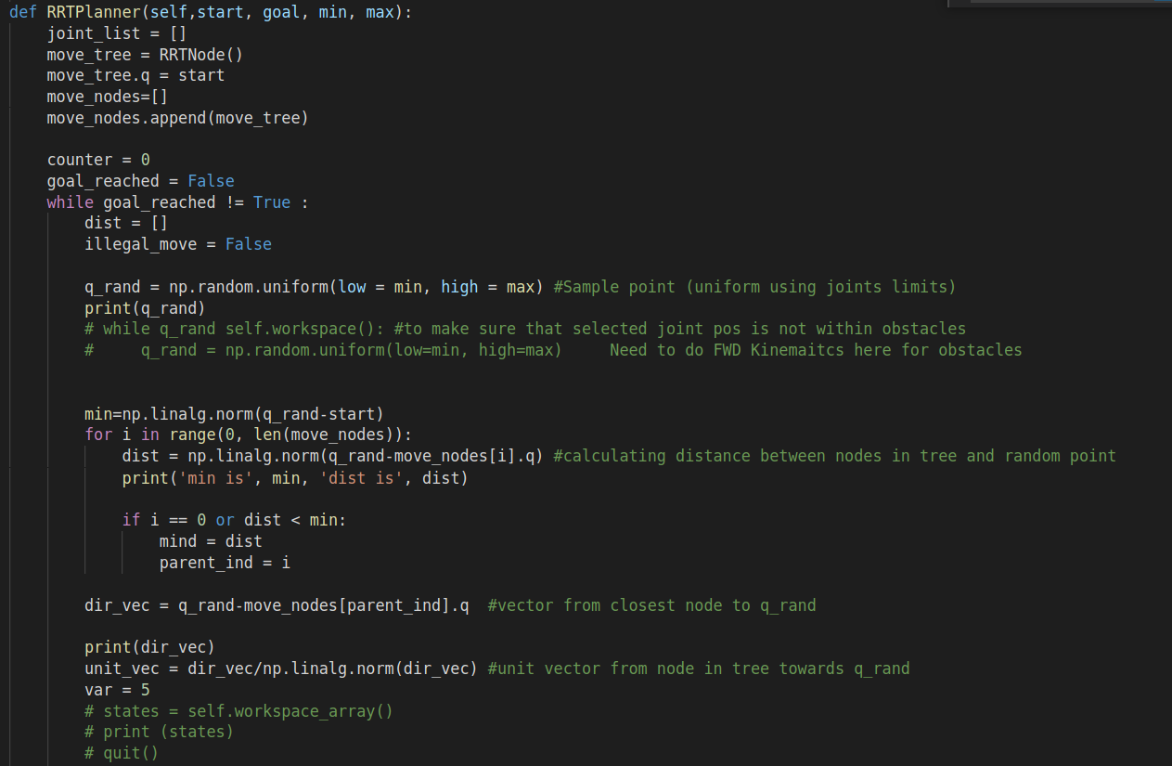
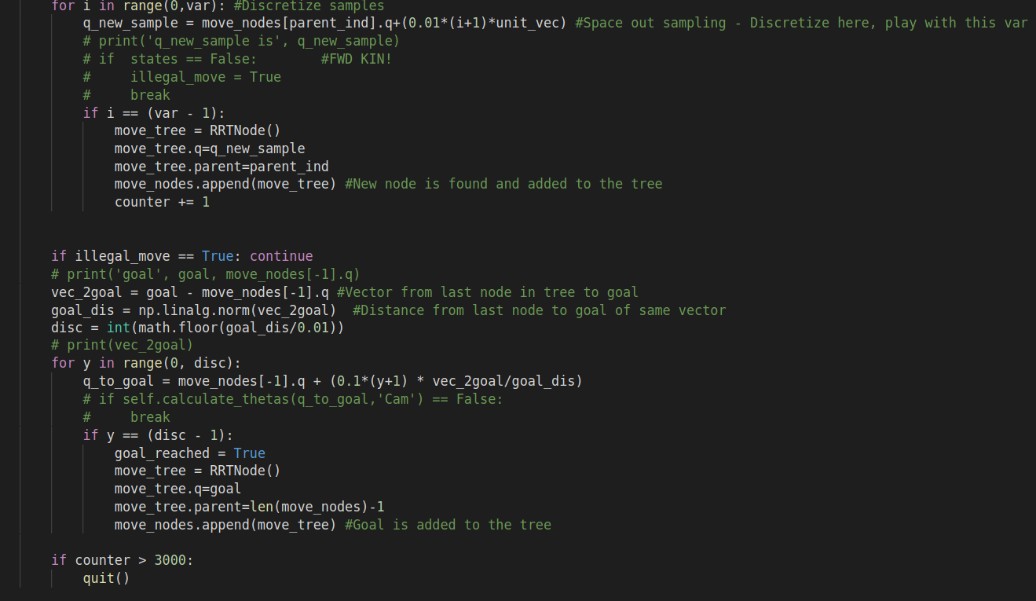
Path Planning (Code Snippets)

Slide 12
Path Planning (Code Snippets)

Slide 13
Takeaways/Future Work
Frame transform management is key - switching between frames OTF
Need to implement RRT planner w/FWD Kinematics, parameterizing on the world coordinate instead of the join variables
MoveIT model can be used as validation for planning

Slide 14
Path Planning using MoveIt
The path planning simulation was verified using the RRT connect motion planning library using the OMPL.
The following steps were taken to implement the procedure on MoveIt.
Setting start and destination points to find out the reachable workspace.
The collisions between different links were preset.
Addition of various obstacles to observe the node traversal of the arms.

Slide 15
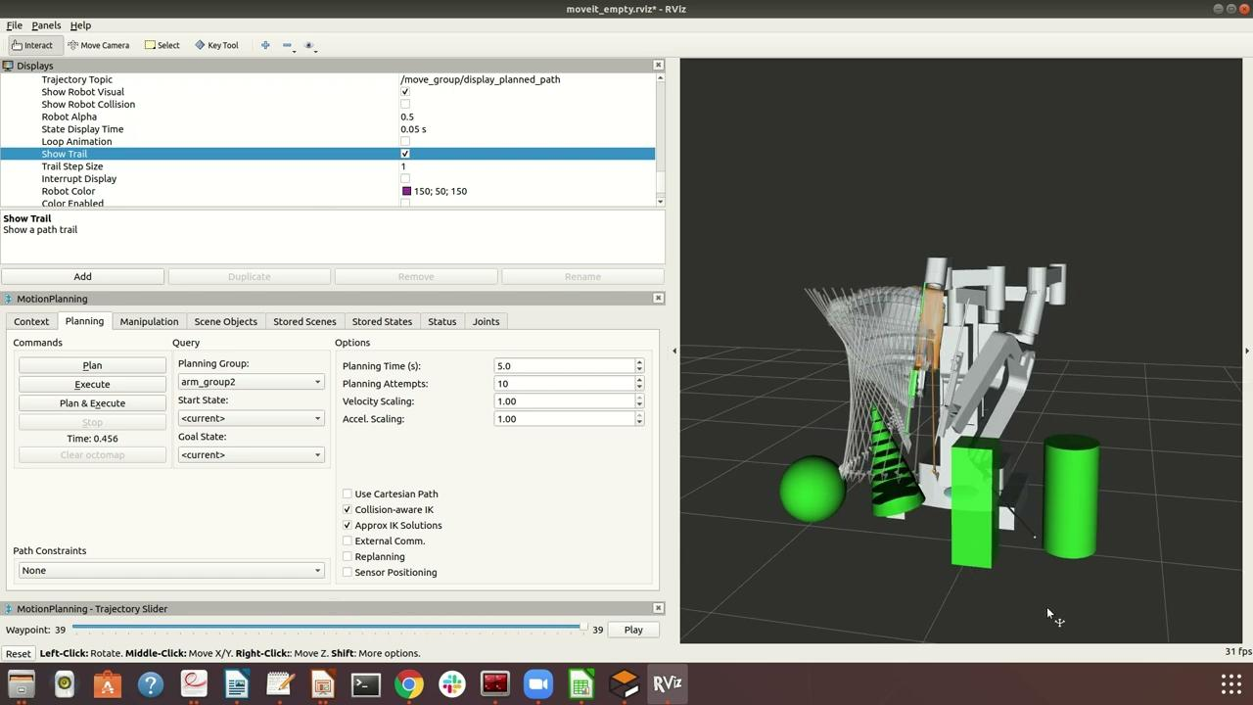
Results using MoveIt

Slide 16
References
S. Lu, T. Shkurti and M. C. Çavuşoğlu, "Dual-Arm Needle Manipulation with the da Vinci®Surgical Robot," 2020 International Symposium on Medical Robotics (ISMR), Atlanta, GA, USA, 2020, pp. 43-49, doi: 10.1109/ISMR48331.2020.9312930.
T. Liu and M. C. Cavusoglu, "Needle Grasp and Entry Port Selection for Automatic Execution of Suturing Tasks in Robotic Minimally Invasive Surgery," in IEEE Transactions on Automation Science and Engineering, vol. 13, no. 2, pp. 552-563, April 2016, doi: 10.1109/TASE.2016.2515161.
S. M. LaValle, “Rapidly-exploring random trees: A new tool for path planning,” 1998.
P. L. Anderson, R. A. Lathrop, S. D. Herrell and R. J. Webster, "Comparing a Mechanical Analogue With the Da Vinci User Interface: Suturing at Challenging Angles," in IEEE Robotics and Automation Letters, vol. 1, no. 2, pp. 1060-1065, July 2016, doi: 10.1109/LRA.2016.2528302.
RRT, RRT* and random trees, https://youtu.be/Ob3BIJkQJEw
Carfagno, Jack. 2019. “Top 5 Robotic Surgery Systems.” Docwire News. May 15, 2019. https://www.docwirenews.com/future-of-medicine/top-5-robotic-surgery-systems/#:~:text=Over%201%2C700%20da%20Vinci%20Systems.
Robotic Surgical Tool, Not Medical Evidence, Drives Free Hernia Screenings.” 2019. FierceBiotech. July 26, 2019.
https://www.fiercebiotech.com/medtech/robotic-surgical-tool-not-medical-evidence-drives-free-hernia-screenings.

Slide 17

Questions?

